Slide 1
BREK EVEN ANALYSIS
ABH,IEM

Slide 2
BREAKEVEN ANALYSIS:
How to Know When You Can Expect a Profit in your Business????

Slide 3
HISTORY
Many entrepreneurs make the mistake of bringing a product or service to the market without fully understanding the total costs involved and the prices they can charge. As a result, they discover they can't sell enough of the product or service to make a profit.

Slide 4
INTRODUCTION
Breakeven analysis is used to determine when your business will be able to cover all its expenses and begin to make a profit. It is important to identify your startup costs, which will help you determine your sales revenue needed to pay.
The breakeven point is reached when revenue equals all business costs. ongoing business expenses.
It enables you to determine with great accuracy whether or not your idea is a profitable one. Best of all, you can use this tool to evaluate every product or service you offer.

Slide 5
ASSUMPTIONS IN CALCULATION
Each business has certain fixed costs that must be paid every month, whether or not any sales take place.
Each product or service has variable costs that are incurred when the product is produced and sold.
Break Even Point is the point where profit = = (fixed cost+Variable cost)

Slide 6
CASE STUDY
The total costs of operating the business each month are $10,000. Each product the company produces can be sold for $1,000. Each product costs an average of $800 per unit to produce, sell and deliver. The profit contribution per unit is therefore $200 each. The amount $200 is divided into $10,000 to determine the break-even point. Next, $10,000 divided by $200 equals 50 units. The company must therefore sell 50 units per month to break even. Only after the company has sold 50 units in one month does it begin to earn a profit of $200 per unit.

Slide 7
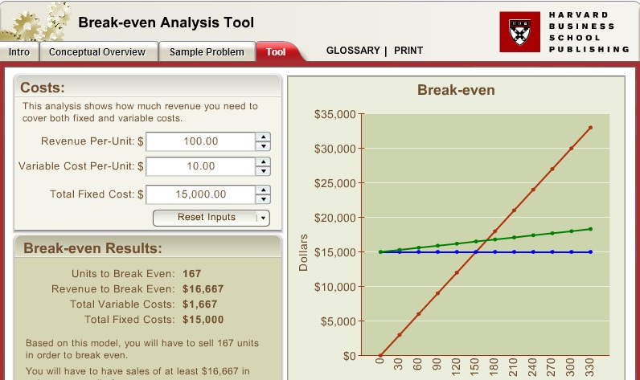

Slide 8
SOLUTION
No of units to break-even is x
So
15000+x*10=100 x
=>90x=15000
=>x=15000/90
=>x=166.66 i,e 167

Slide 9
END

